Slide 1






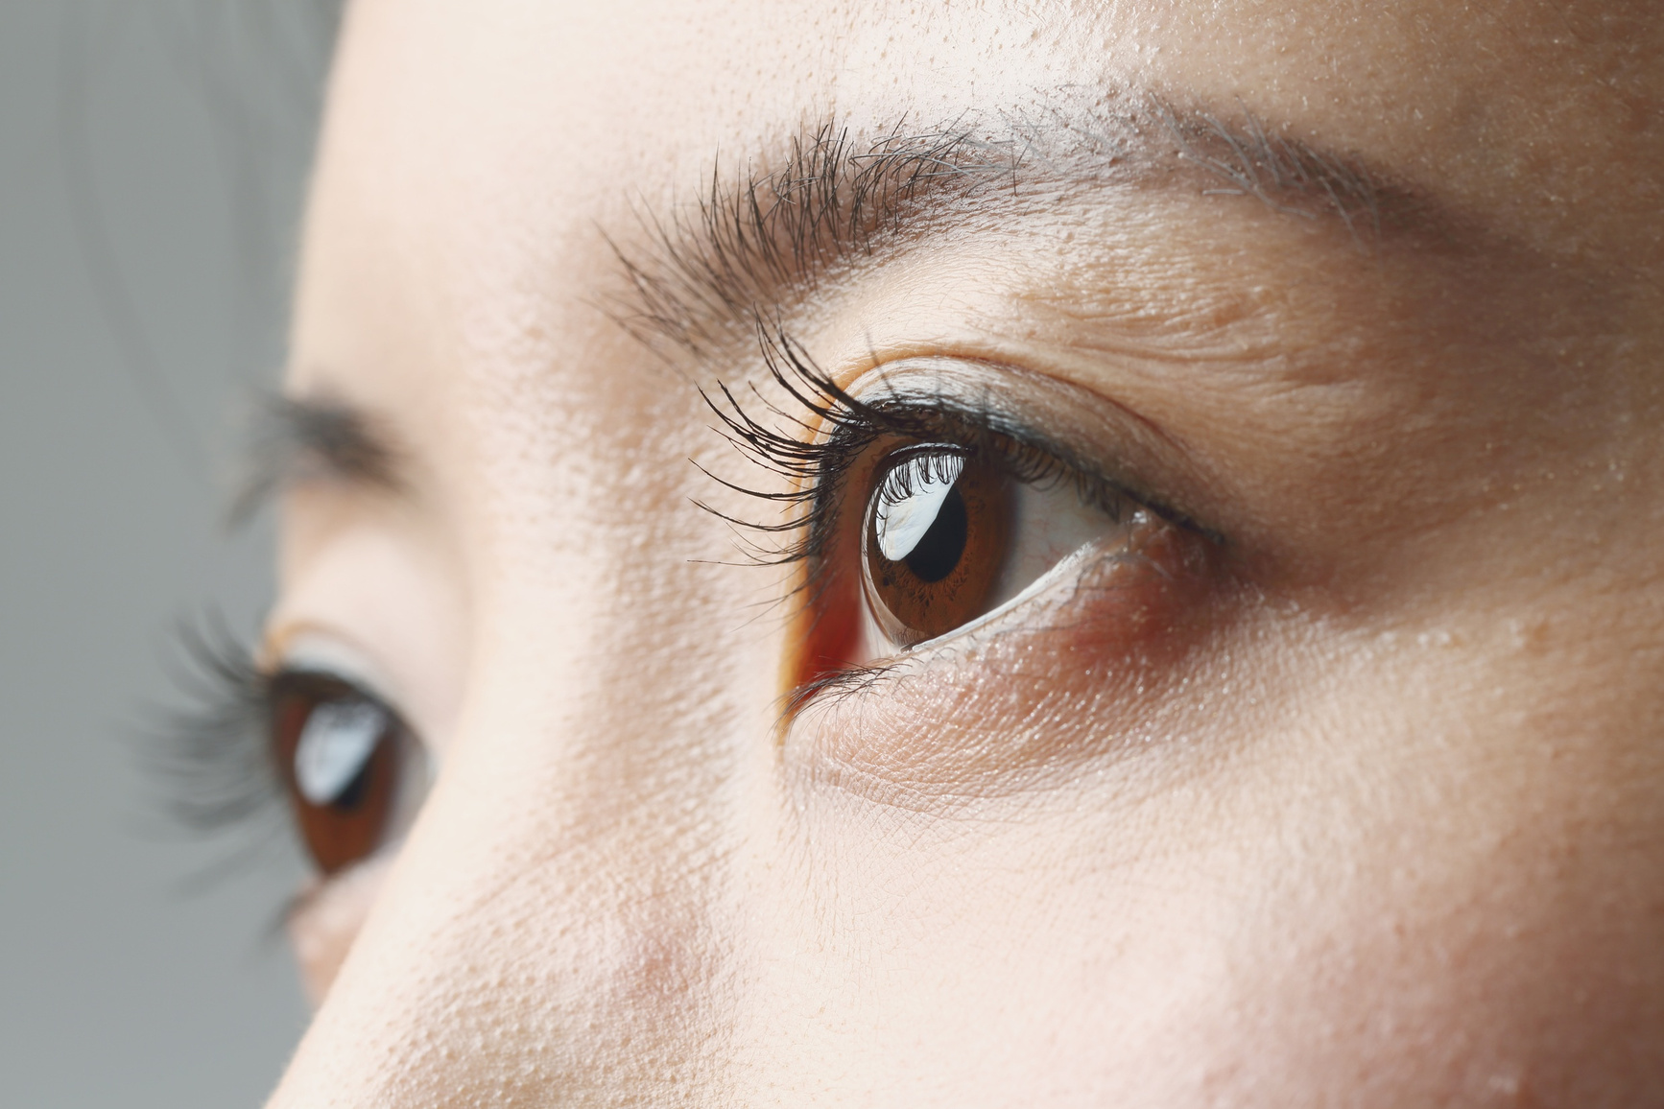

PREMIER UNIVERSITY
CHATTOGRAM
Eye Disease Detection and Classification Using Deep Learning
Visit Our Website
puc.ac.bd

Slide 2

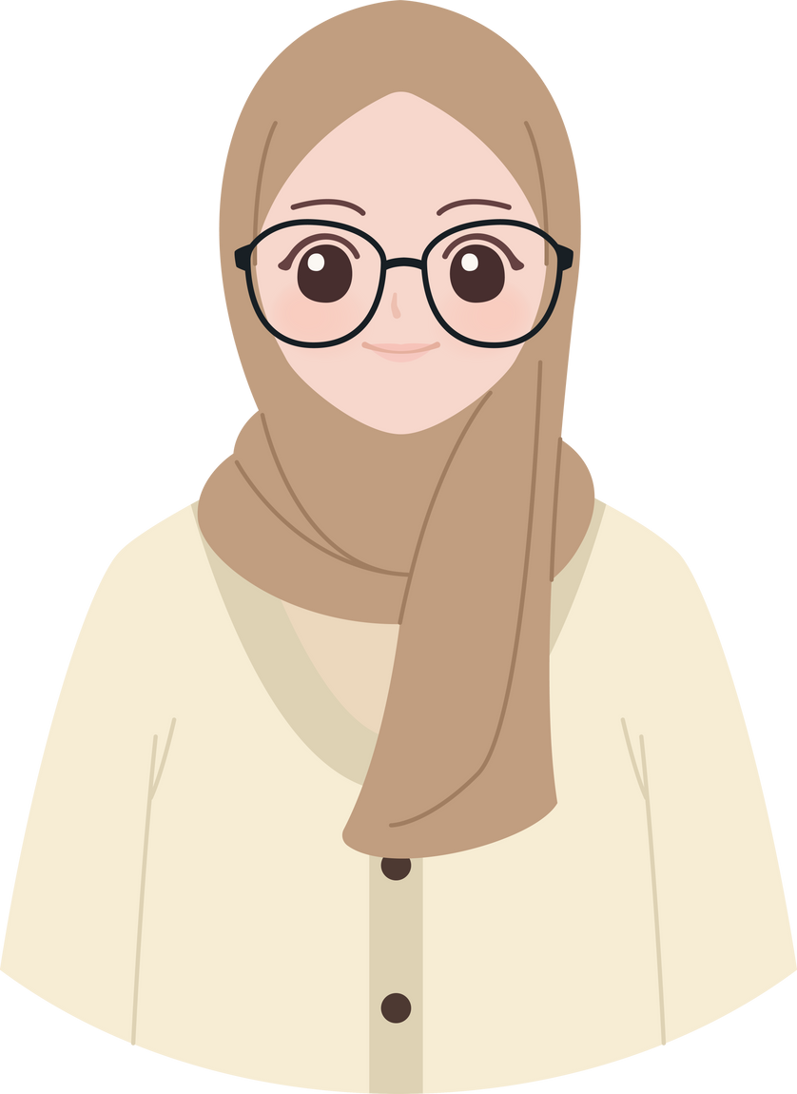

MEET OUR
TEAM MEMBERS
SABRINA AKTER
MD NURNABI RANA
210401020289
2104010202290

Slide 3





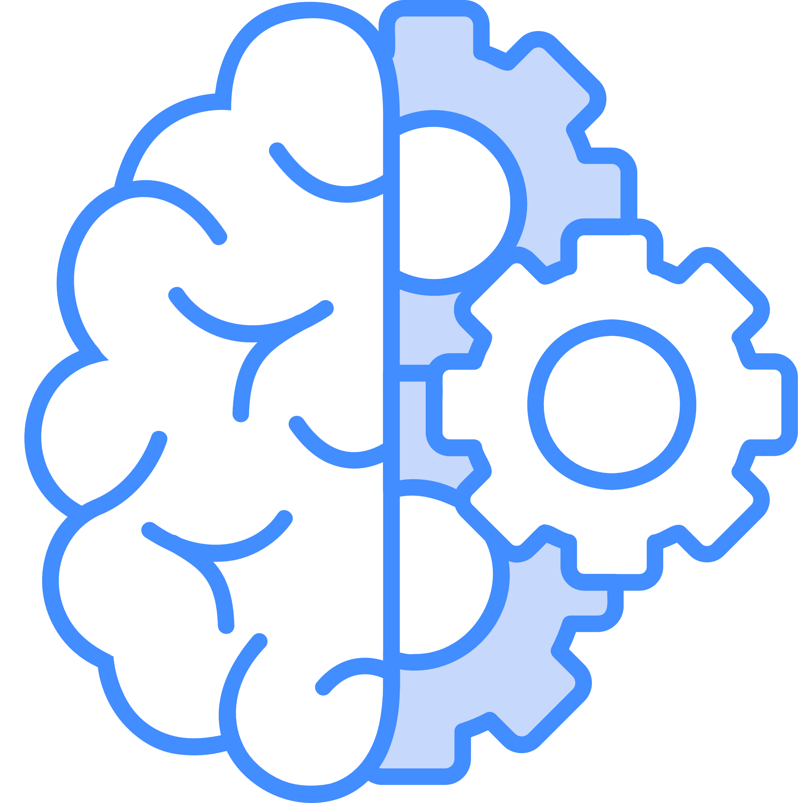
BACKGROUND OF OUR STUDY
Global Health Concern
Eye diseases cause millions of blindness cases worldwide if left untreated.
Importance of Early Detection
Timely and accurate diagnosis helps prevent permanent vision loss.
Limitations of Manual Screening
Traditional diagnosis is slow, subjective, and depends on expert availability
Rise of Deep Learning
DL enables automated, scalable, and objective eye disease detection.
Promise of Modern Architectures
CNNs and Transformers achieve high accuracy in medical image analysis

Slide 4





PRESENTATION OVERVIEW
AGENDA
Background of Our Study
01
Model - DenseNet121
05
Data Preview
02
Model - ResNet50
06
Data Preprocessing
03
Testing
07
Model - EfficientB7
04
Our Message & Conclusion
08

Slide 5
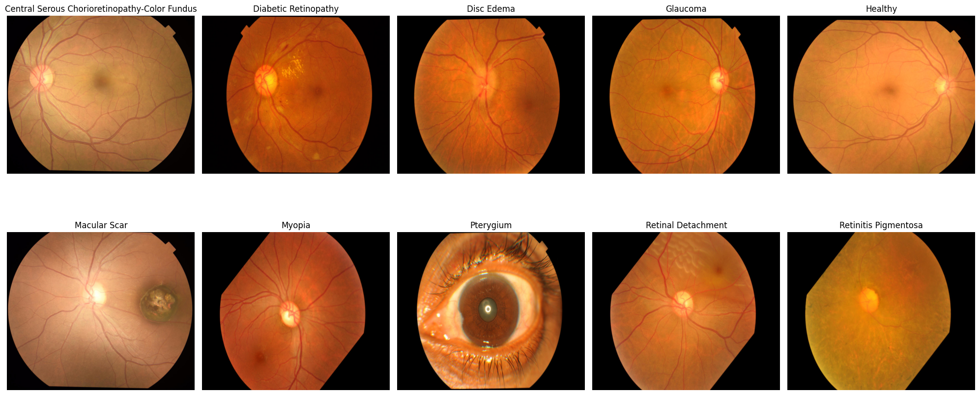
DATASET PREVIEW

Slide 6
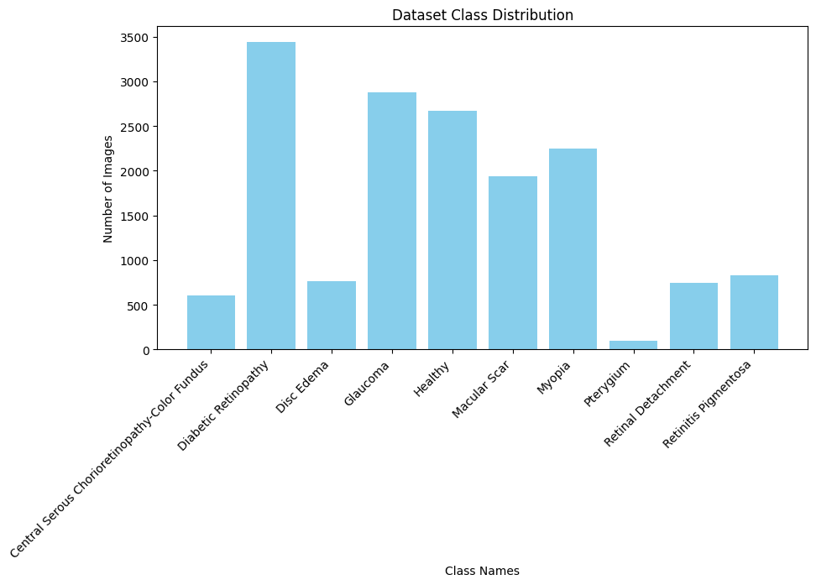
CLASS DISTRIBUTION

Slide 7



Data Preprocessing Techniques
Image Resizing
Normalization
Data Augmentation
Dataset Splitting
Label Verification & Balancing

Slide 8

EfficientNetB7
It is about putting effort
and ideas into action.

Slide 9
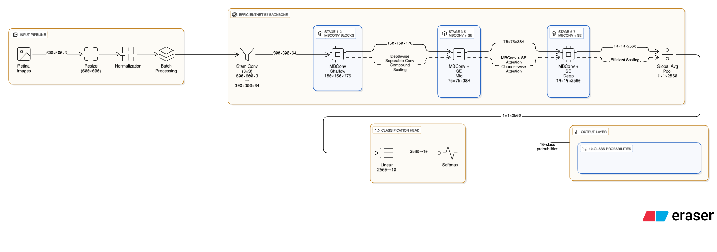

Model Architechture

Slide 10
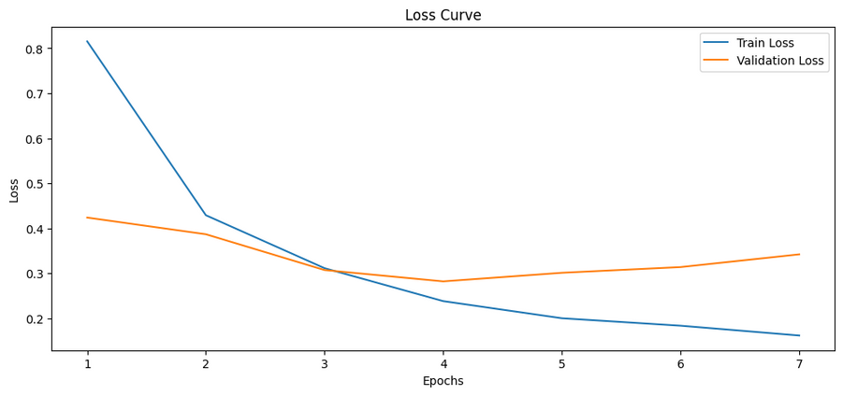
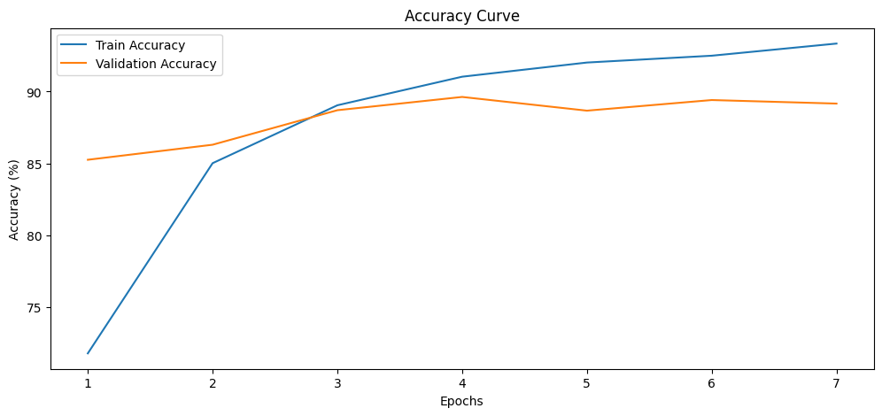
Model Evaluation
Loss curve
Accuracy Curve

Slide 11
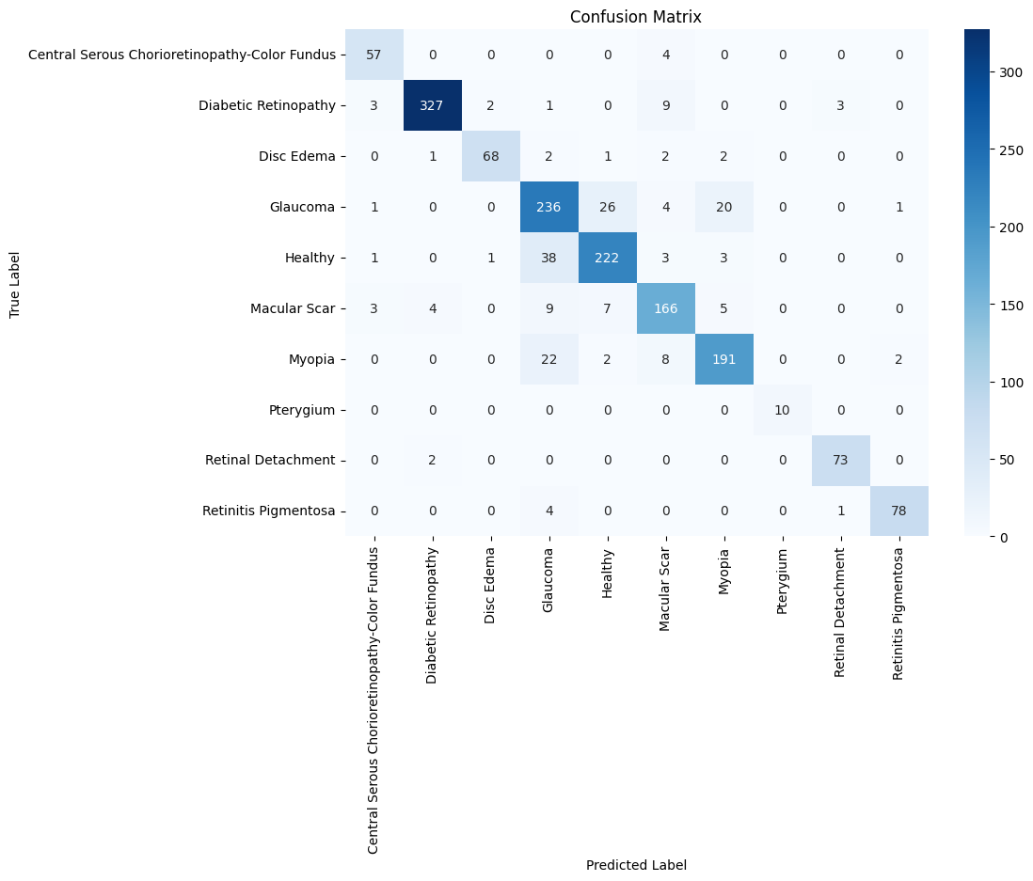
Confusion matrix

Slide 12
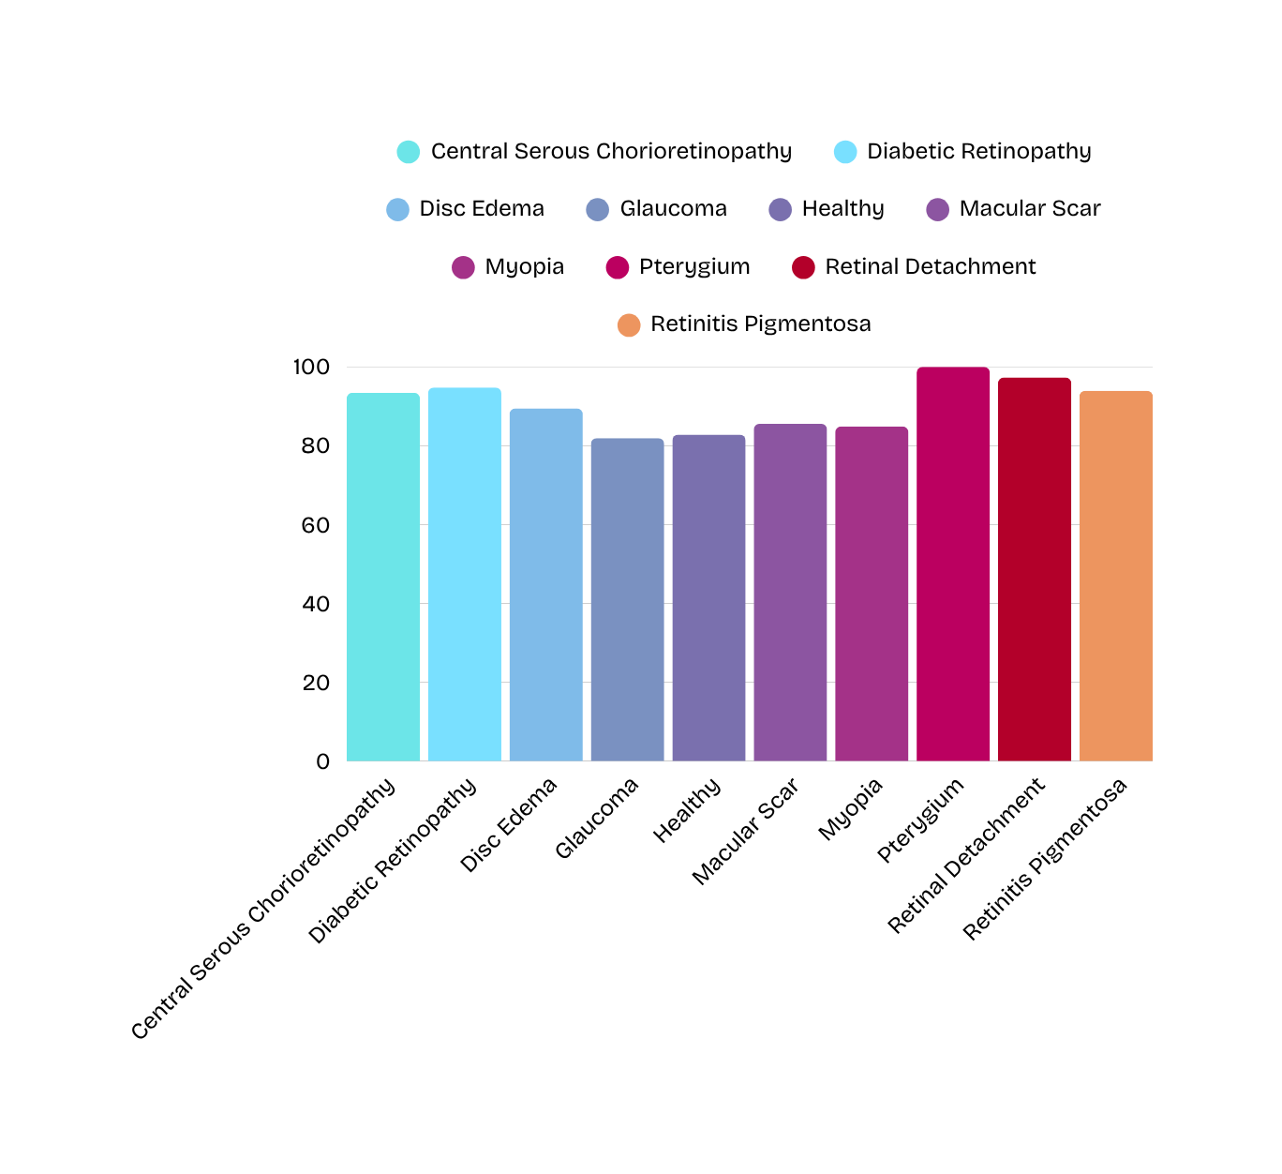
Model Accuracy
Per Class

Slide 13

DenseNet121
It is about putting effort
and ideas into action.

Slide 14
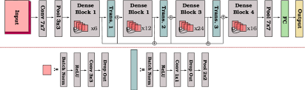
Model Architechture

Slide 15
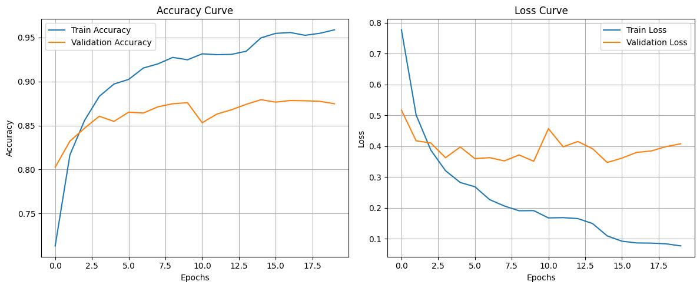
Model Evaluation

Slide 16
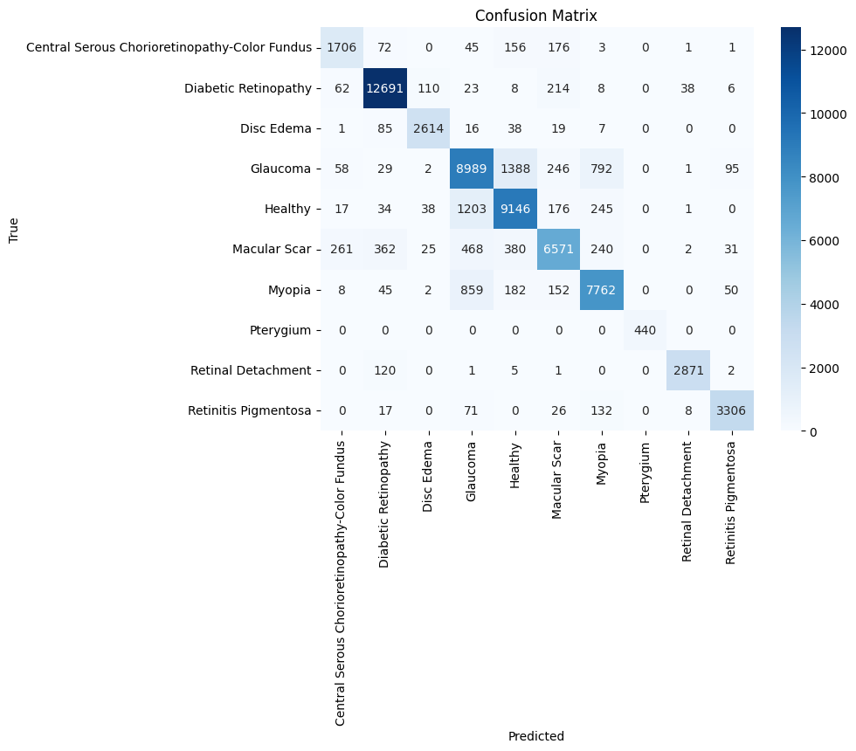
Confusion matrix

Slide 17
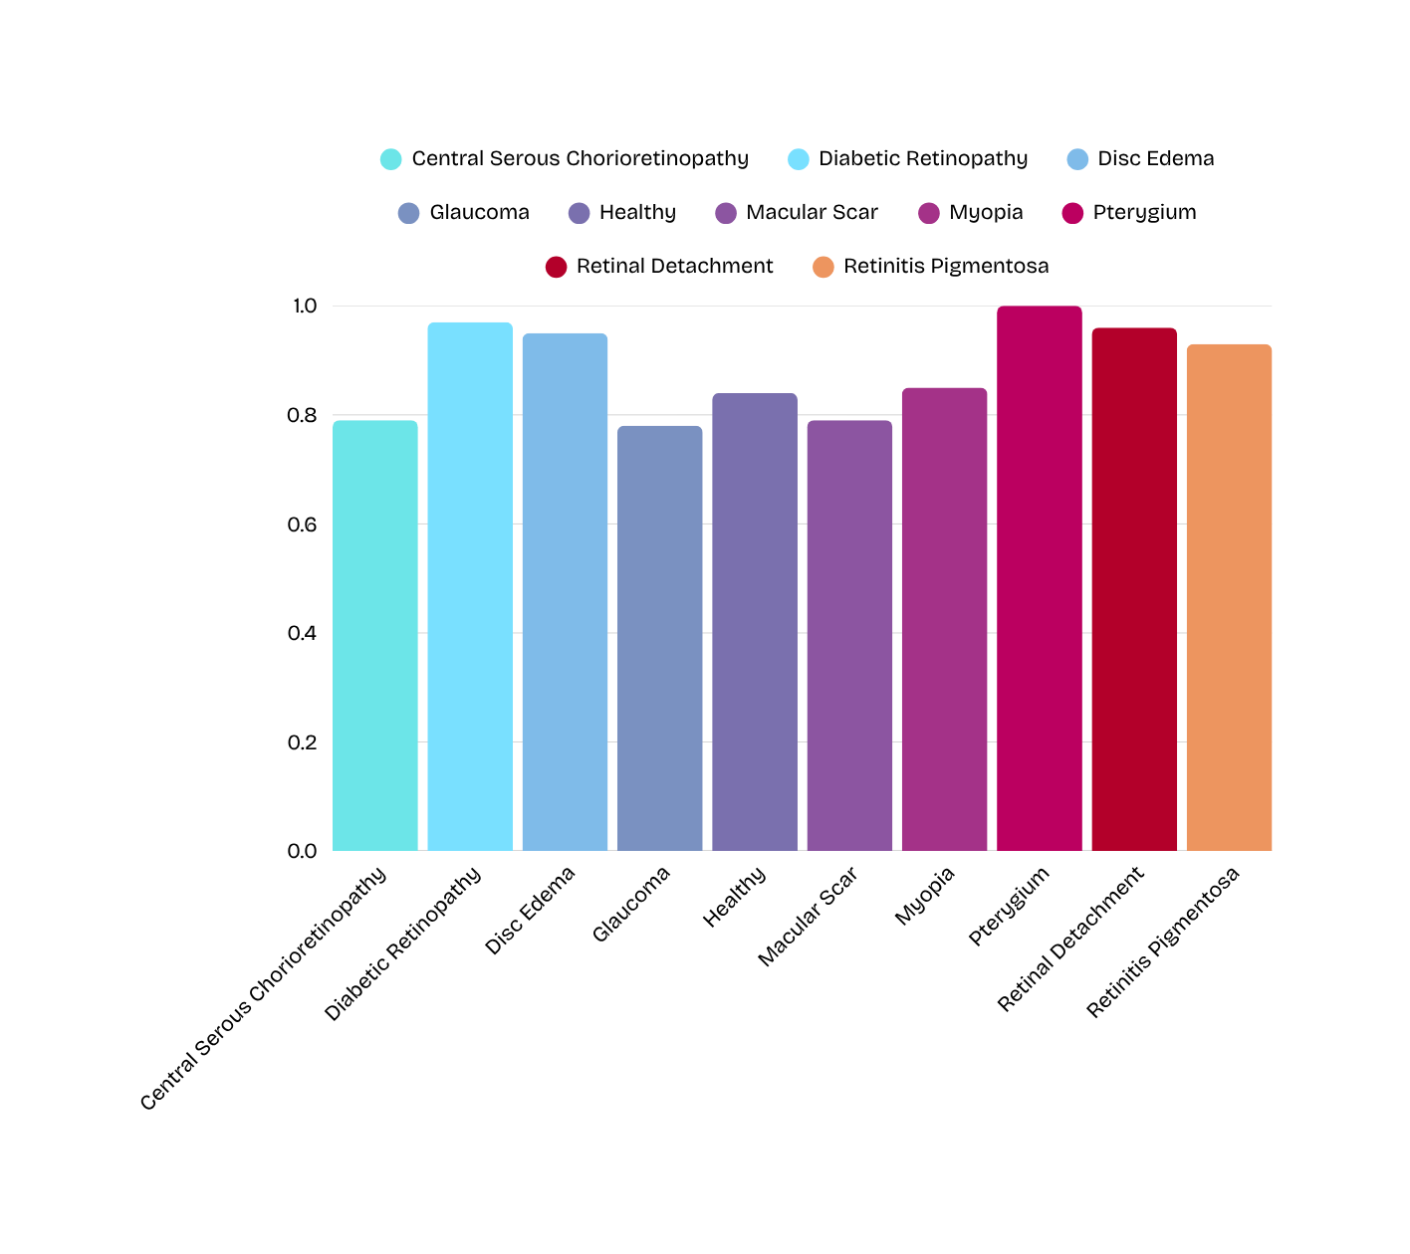
Model Accuracy
Per Class

Slide 18
ResNet50
It is about putting effort
and ideas into action.

Slide 19
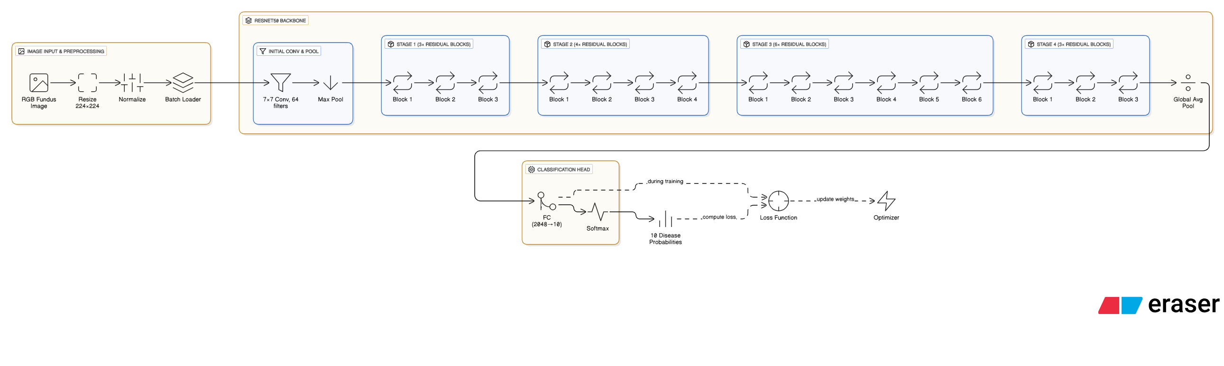
Model Architecture

Slide 20
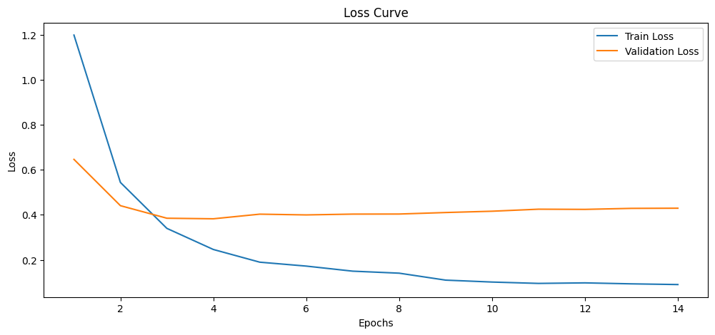
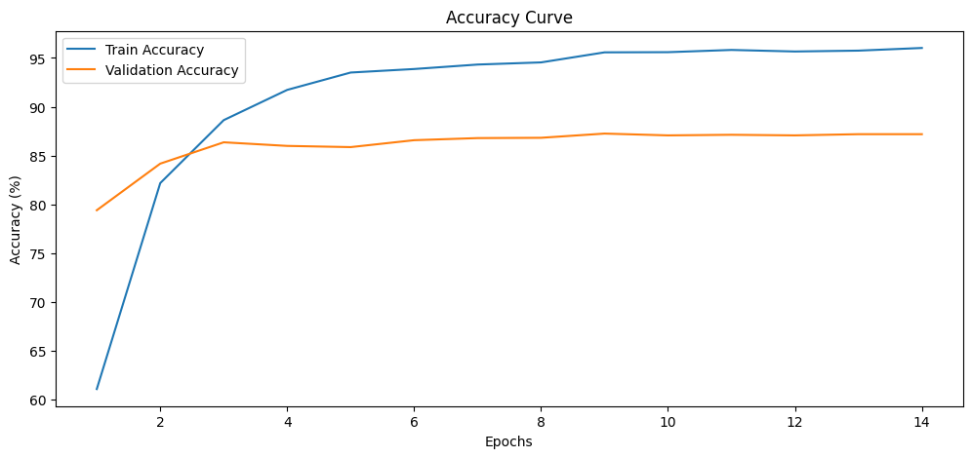
Model Evaluation
Loss curve
Accuracy Curve

Slide 21
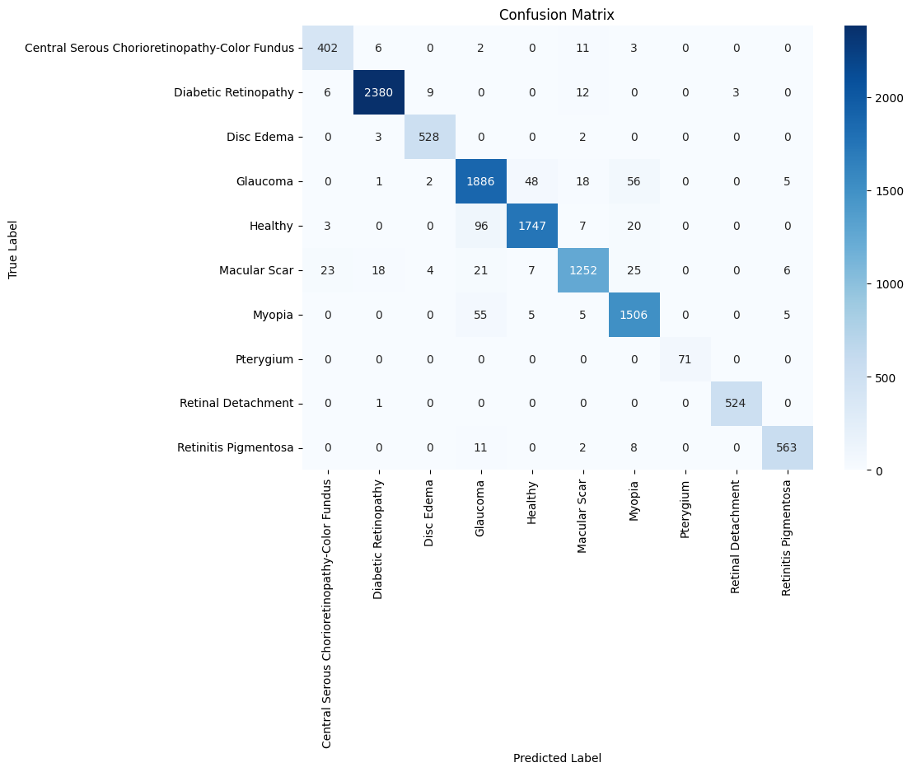
Confusion matrix

Slide 22
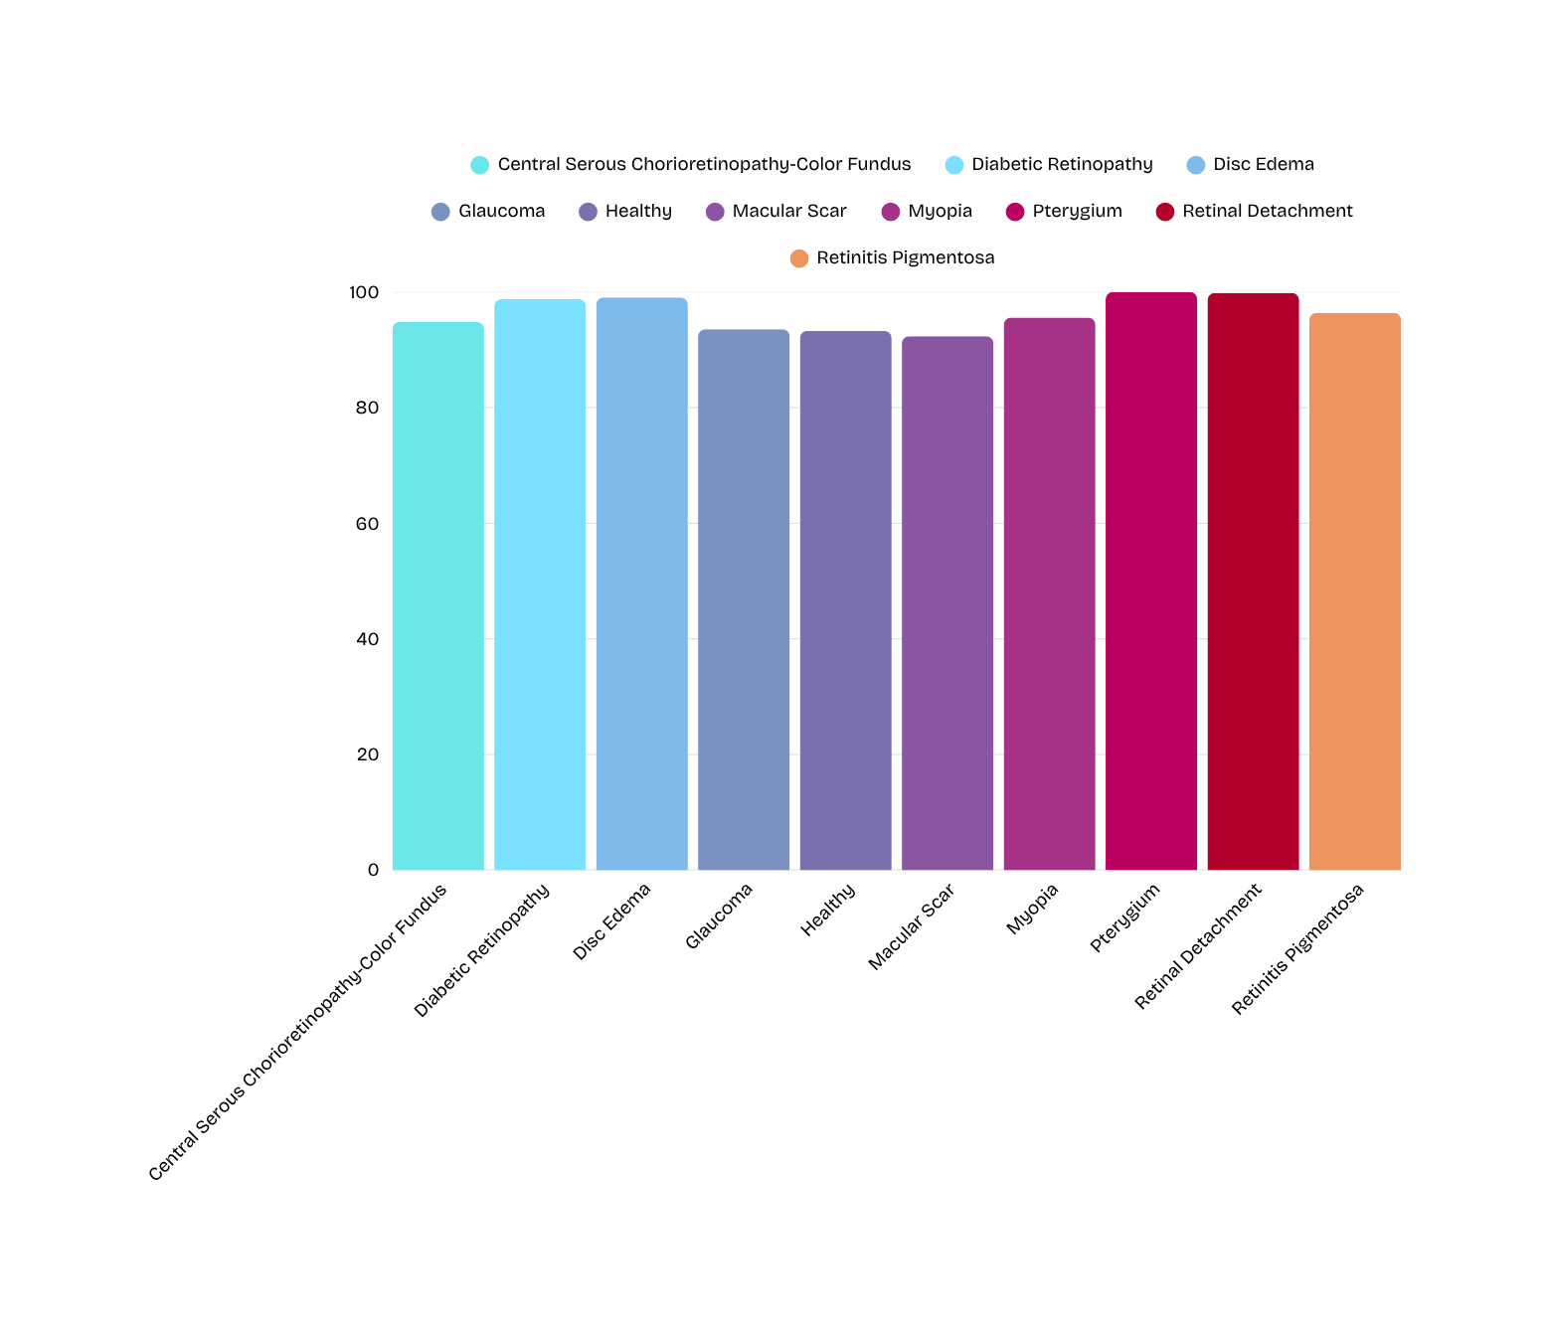
Model Accuracy
Per Class

Slide 23
Testing
It is about putting effort
and ideas into action.

Slide 24
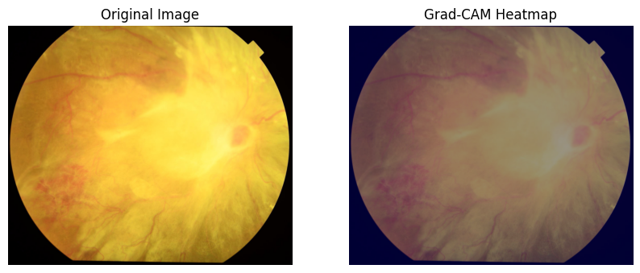
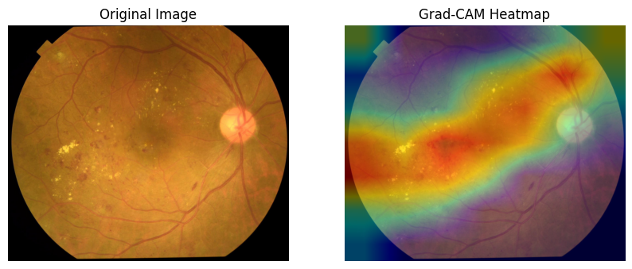
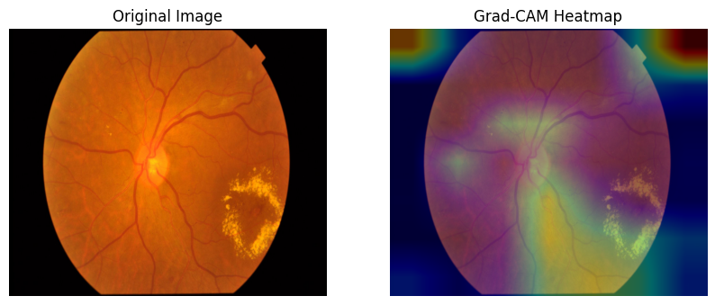
What model looking At?

Slide 25
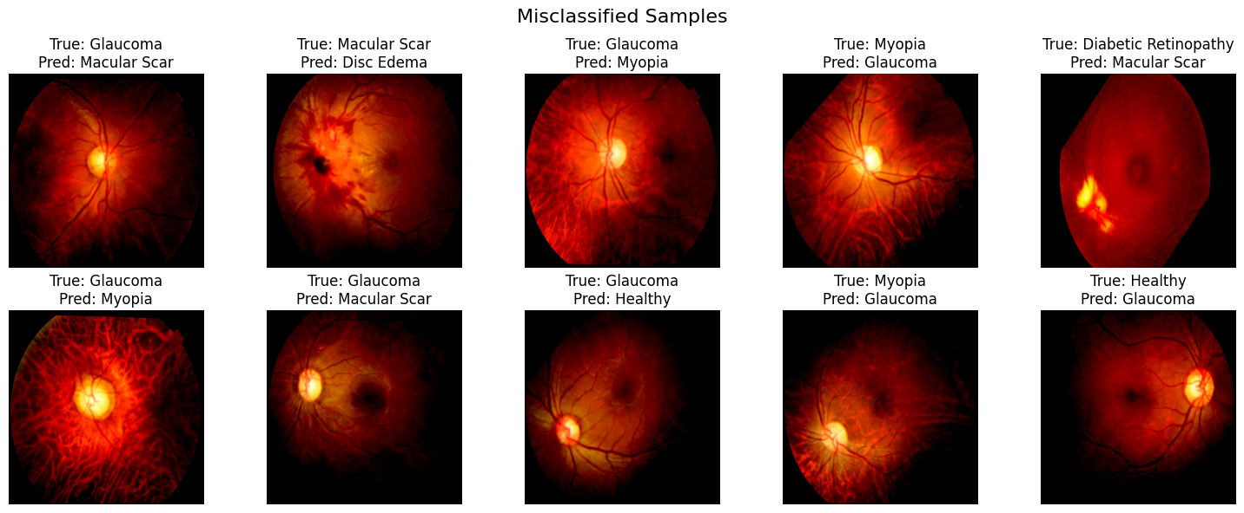
Some Misclassified Samples

Slide 26
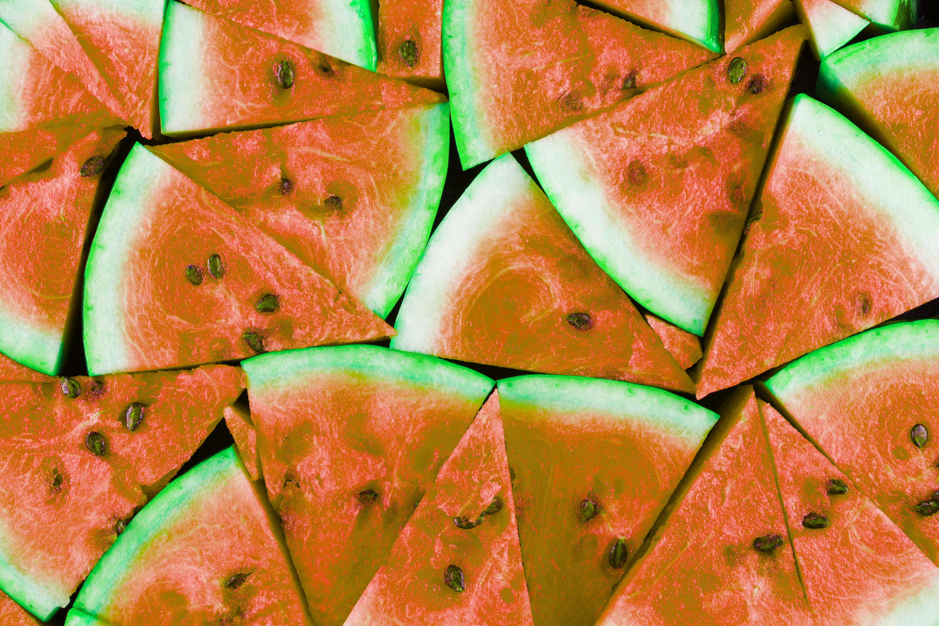

Message of Humanity

Slide 27

PREMIER UNIVERSITY
CHATTOGRAM
Thank You For Your
Attention!!
Visit Our Website
puc.ac.bd

